Slide 1
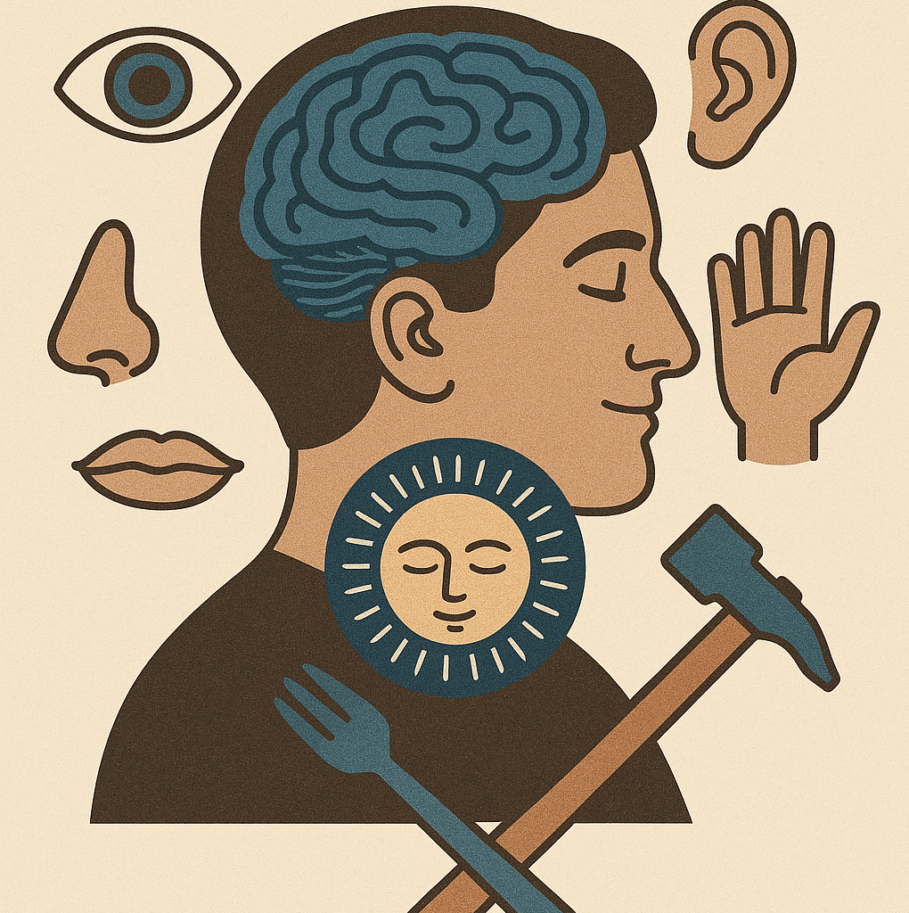
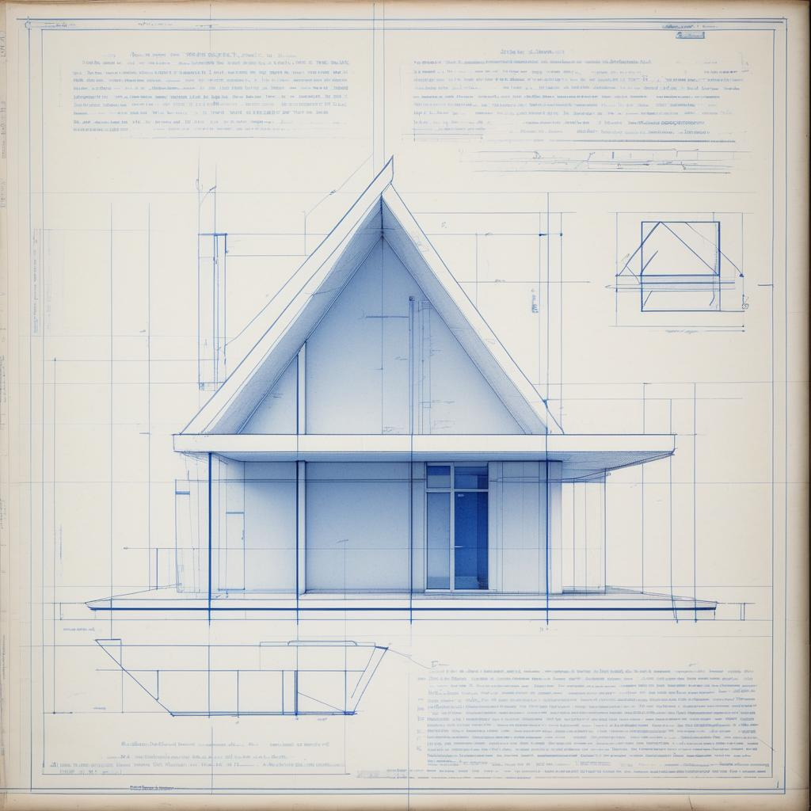
RL-based Reasoning MLLM: What has the community done? What could the community do next?
"The senses are the organs by which man perceives the world, and the soul acts through them as through tools."
— Leonardo da Vinci

Slide 2
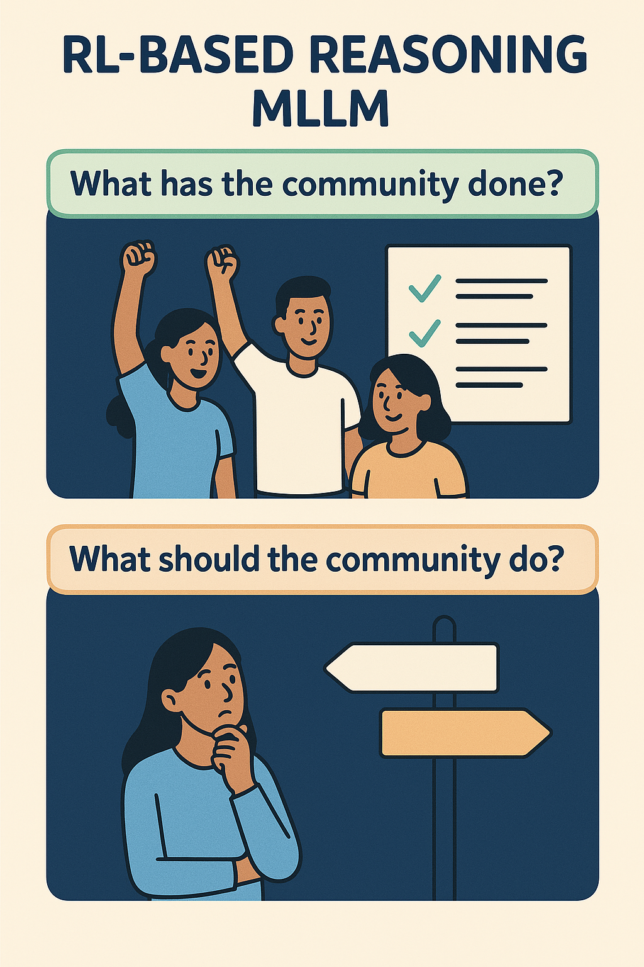
What has the community done?

Slide 3
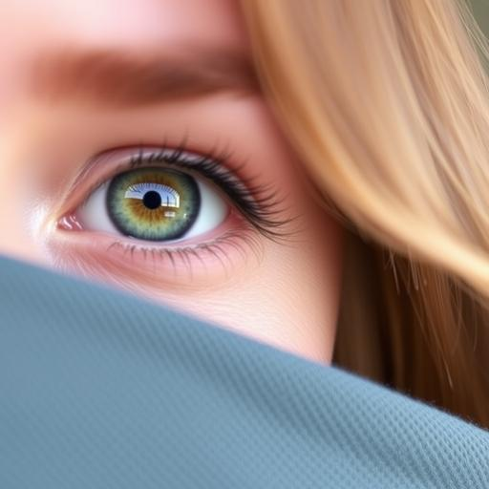
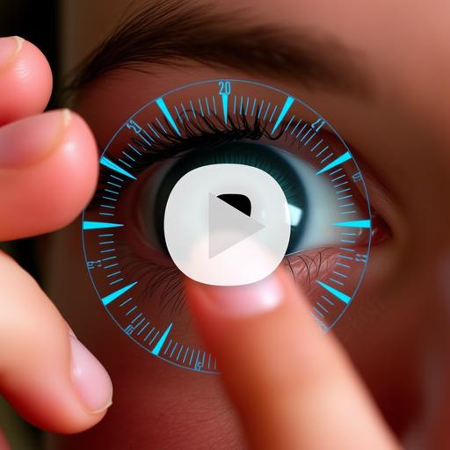
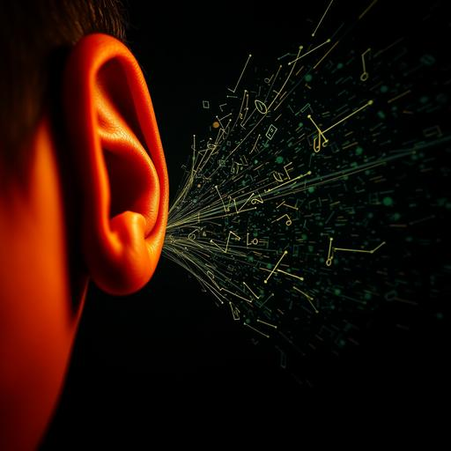
First Success: Multimodality
Vision (perception)：Image
Vision (Temporal)：Video
Audio
R1-V
VLM-R1
R1-Vision
MMR1
Visual-RFT
MM-Eureka
Seg-Zero
Vision-R1
VisualThinker-R1-Zero
R1-VL
OThink-MR1
Think or Not Think
OpenVLThinker
Reason-RFT
Q-Insight
R1-Zero-VSI
Ocean-R1
……
Temporal-R1
SEED-Bench-R1
Video-R1
TimeZero
Open R1 Video
Open-LLaVA-Video-R1
……
Audio-Reasoner
R1-AQA
……

Slide 4

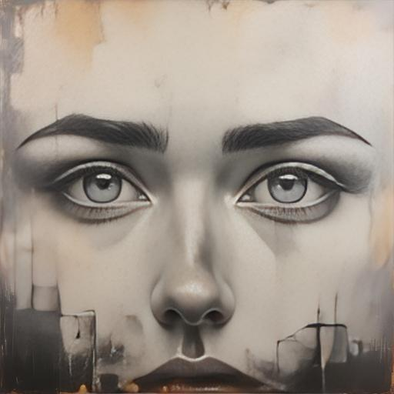
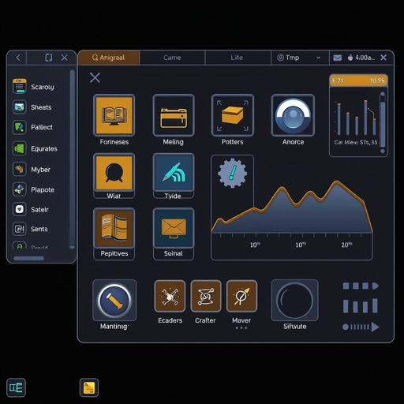

First Success: Multimodality
Medical Vision
Omni
Graphical User Interface
Metaverse
MedVLM-R1
Med-R1
……
R1-Omni
……
UI-R1
……
MetaSpatial
……

Slide 5
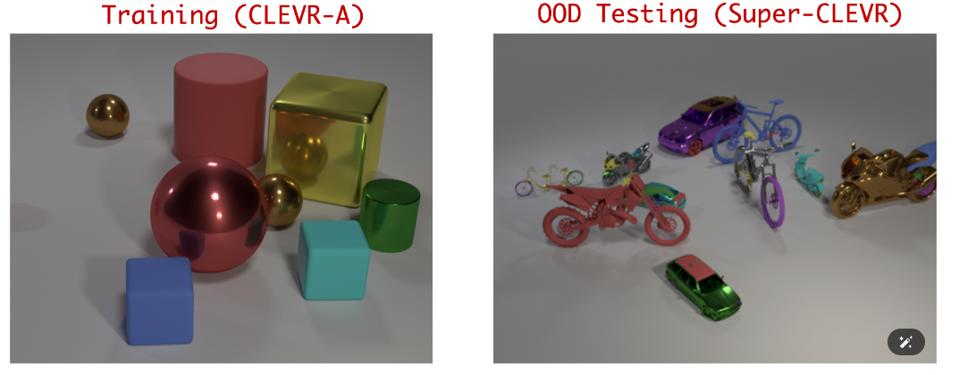
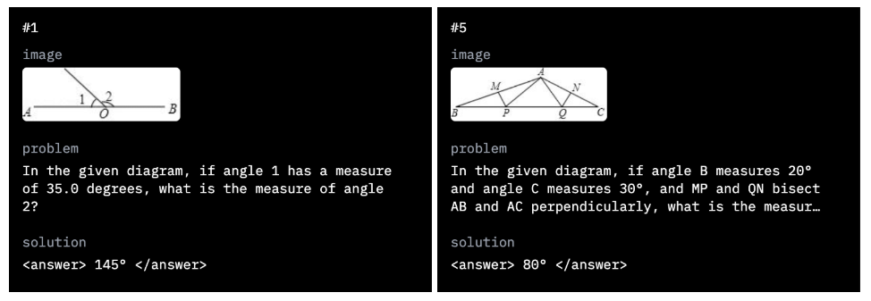
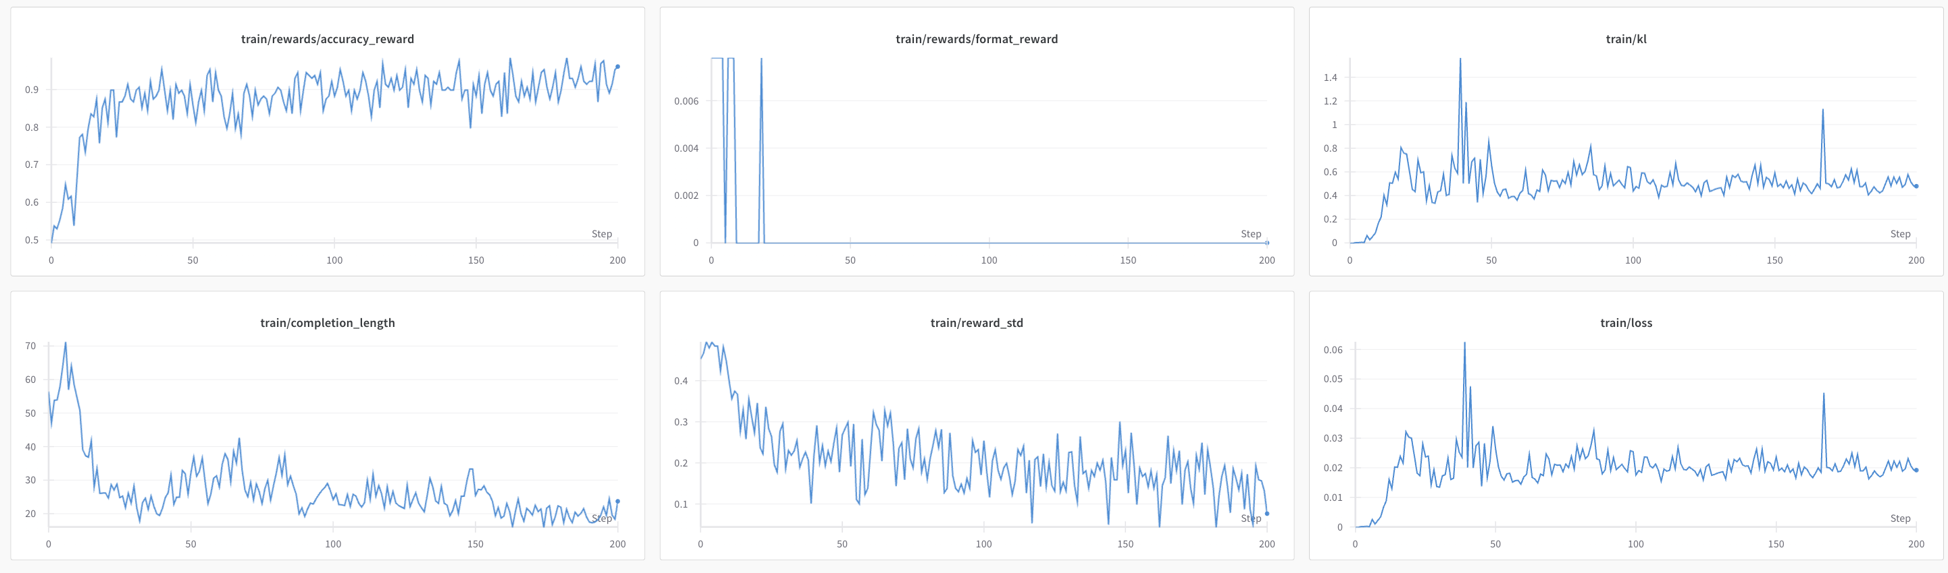
Second Success: Diverse Task——Take Vision as an Example
R1-V
Vision Counting
Geometry Reasoning

Slide 6
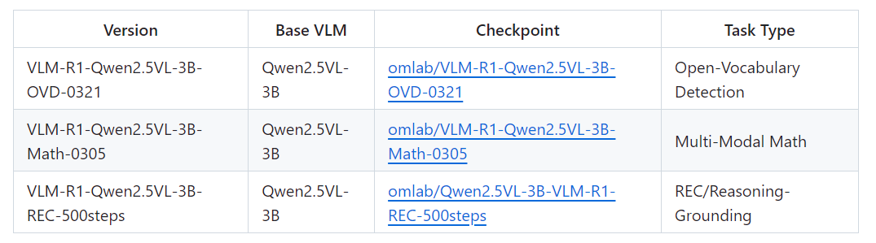
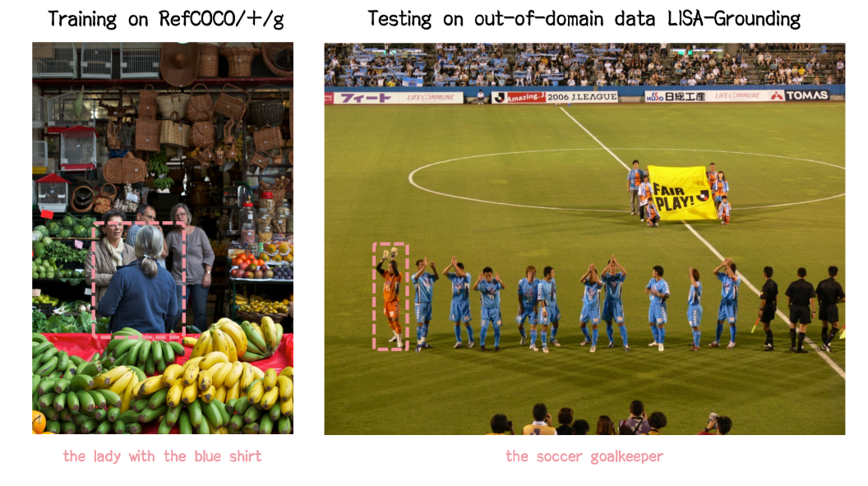
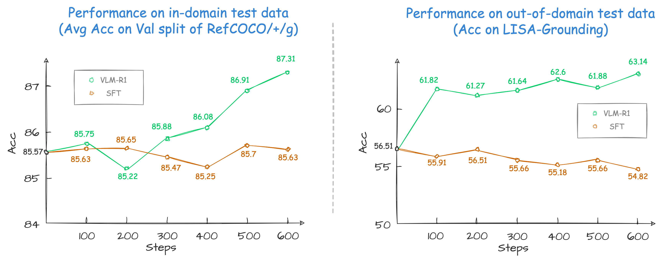
Second Success: Diverse Task——Take Vision as an Example
VLM-R1

Slide 7
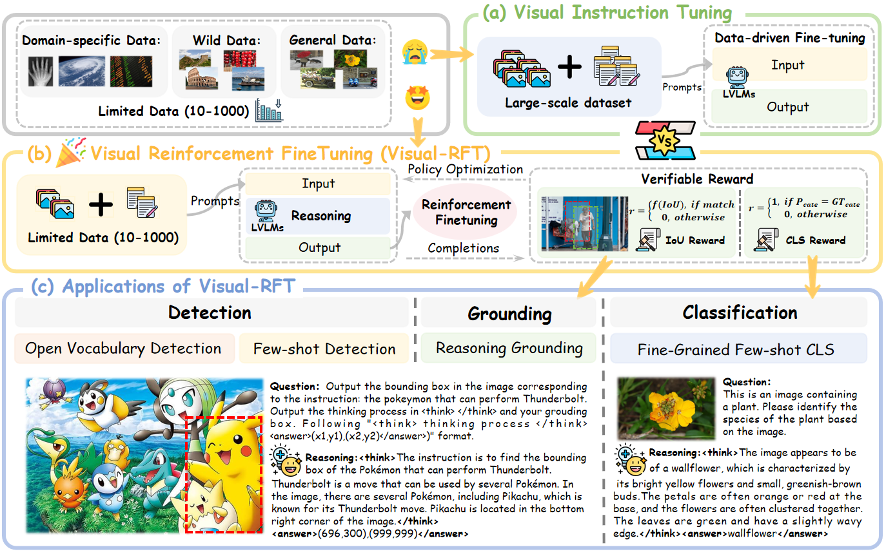
Second Success: Diverse Task——Take Vision as an Example
Visual-RFT

Slide 8
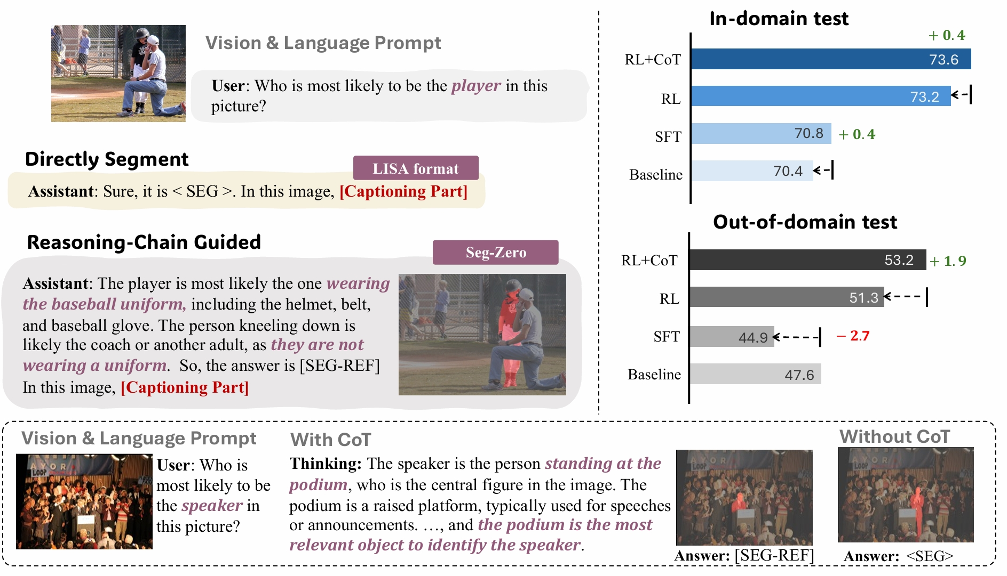
Second Success: Diverse Task——Take Vision as an Example
Seg-Zero

Slide 9
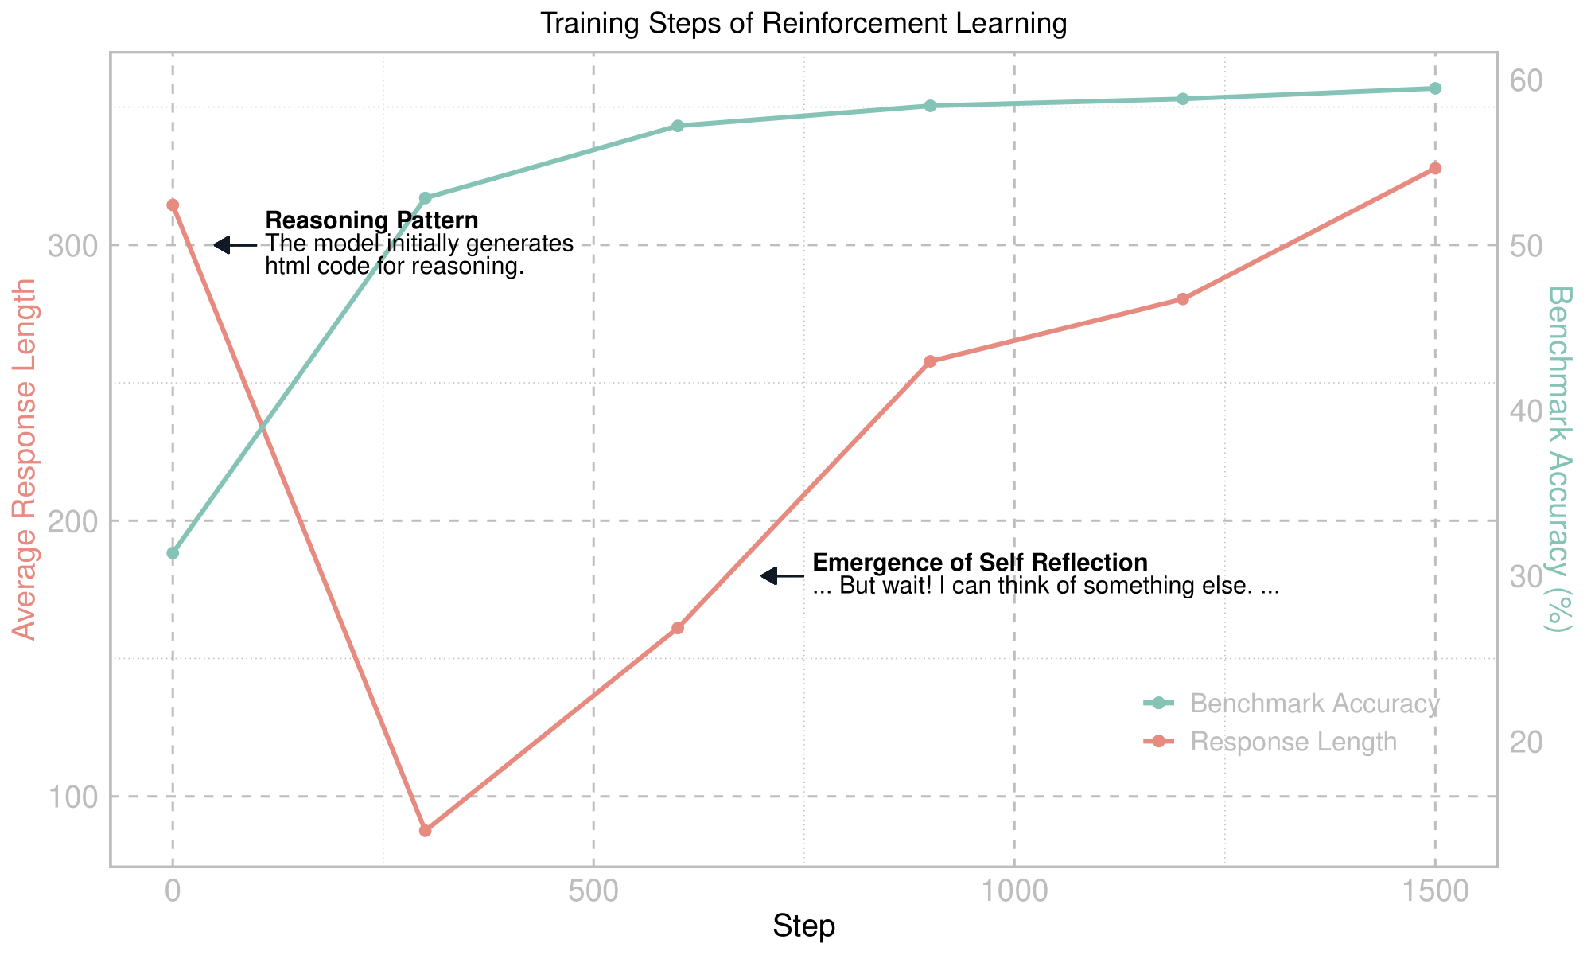
Second Success: Diverse Task——Take Vision as an Example
VisualThinker-R1-Zero
CVBench: Cambrian Vision-Centric Benchmark——2D and 3D understanding

Slide 10
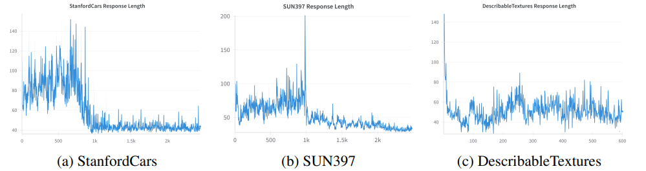
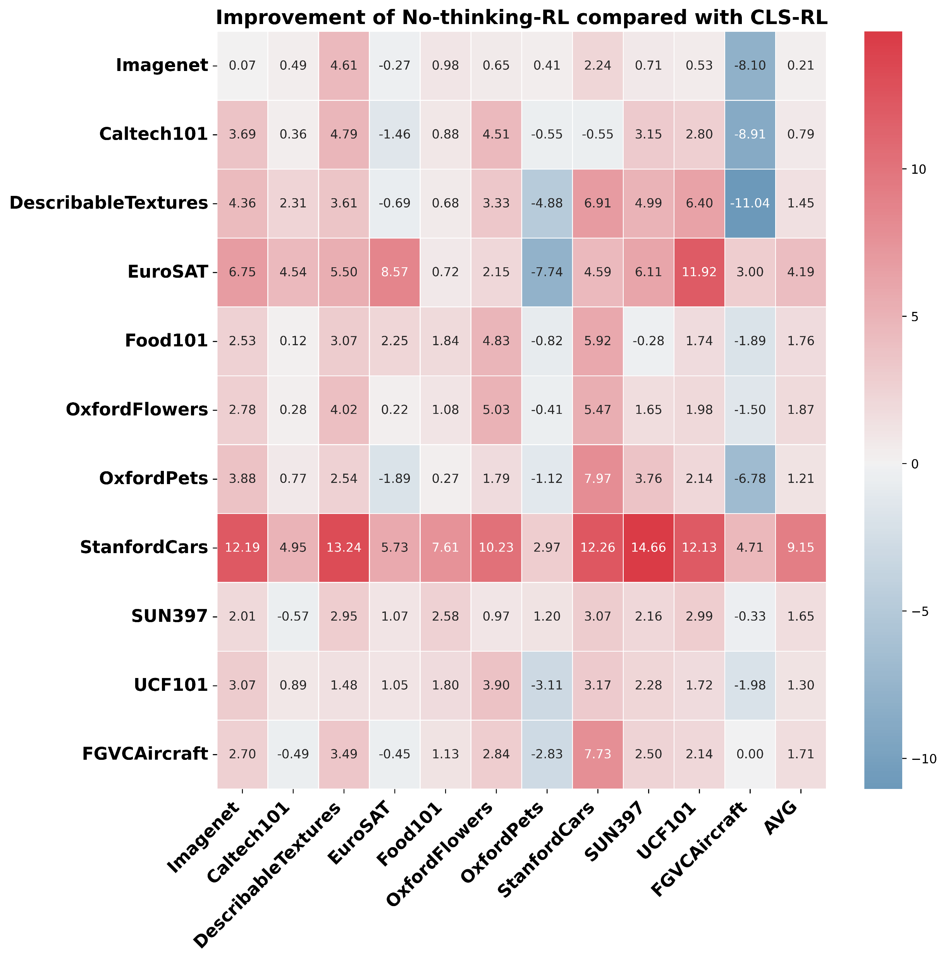
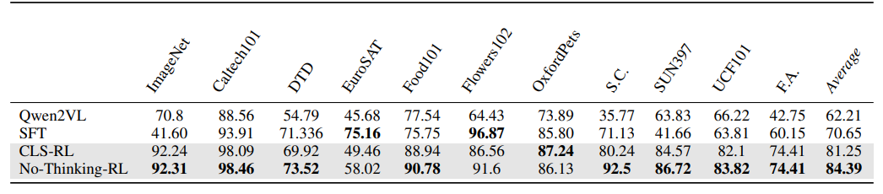
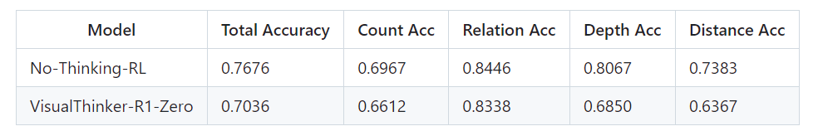
Second Success: Diverse Task——Take Vision as an Example
Think or Not Think
Image Classification

Slide 11
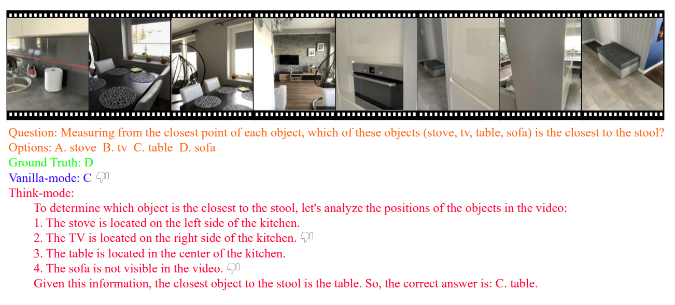
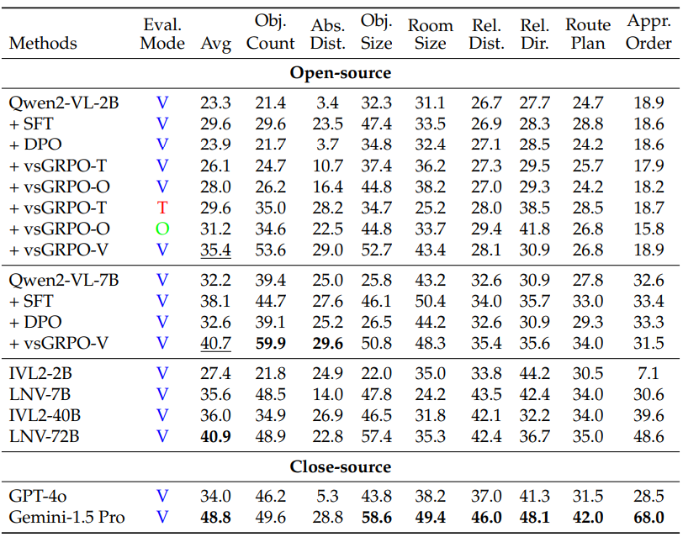
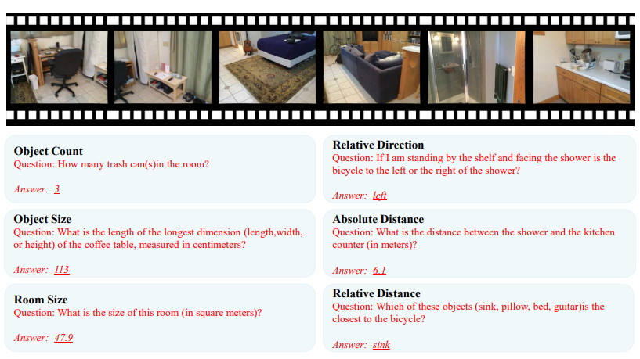
Second Success: Diverse Task——Take Vision as an Example
Visual-Spatial Reasoning

Slide 12
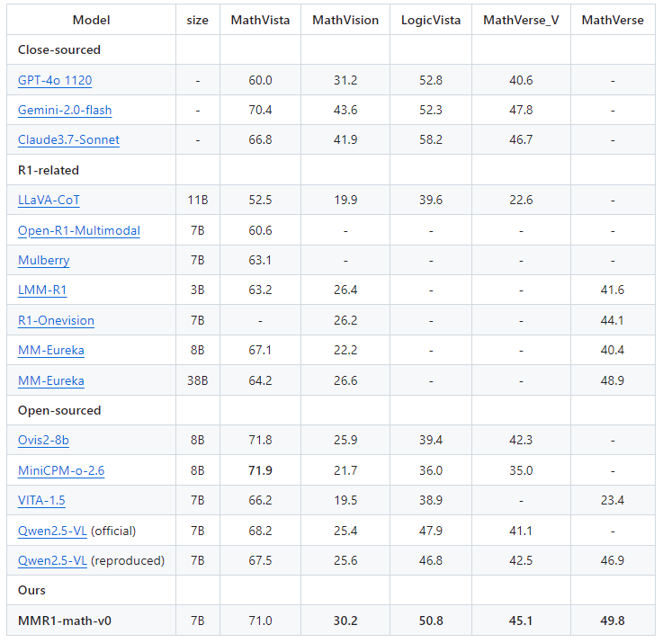
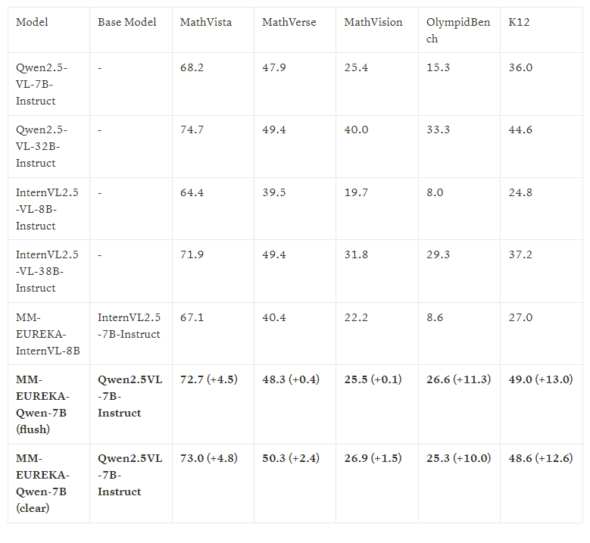
Second Success: Diverse Task——Take Vision as an Example
MMR1，MM_Eureka
Visual Math Reasoning

Slide 13
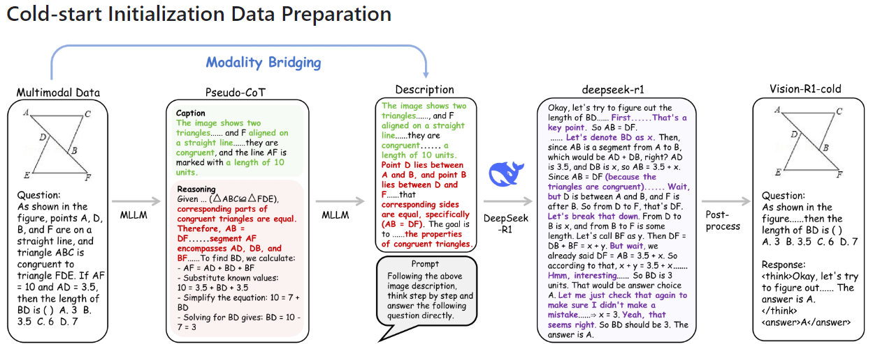
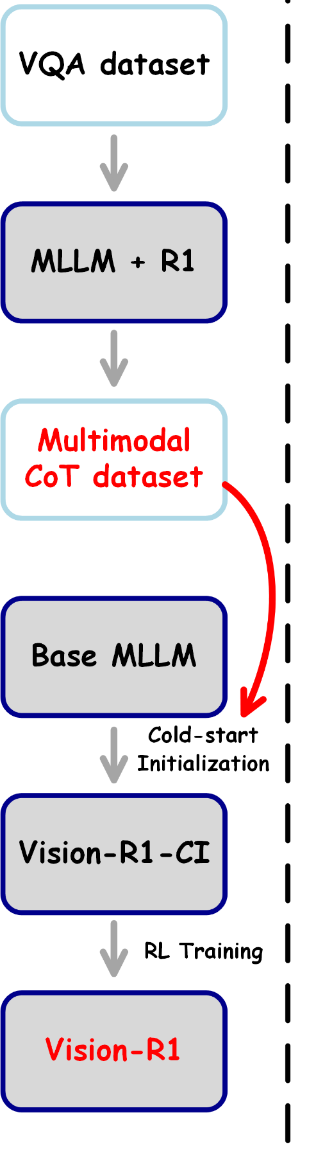
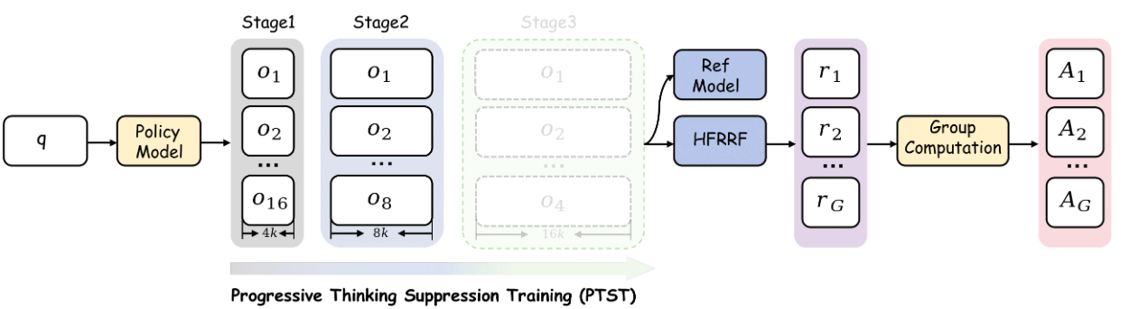
Second Success: Diverse Task——Take Vision as an Example
Vision-R1
Visual Math Reasoning

Slide 14

Second Success: Diverse Task——Take Vision as an Example
Vision-R1
Visual Math Reasoning

Slide 15
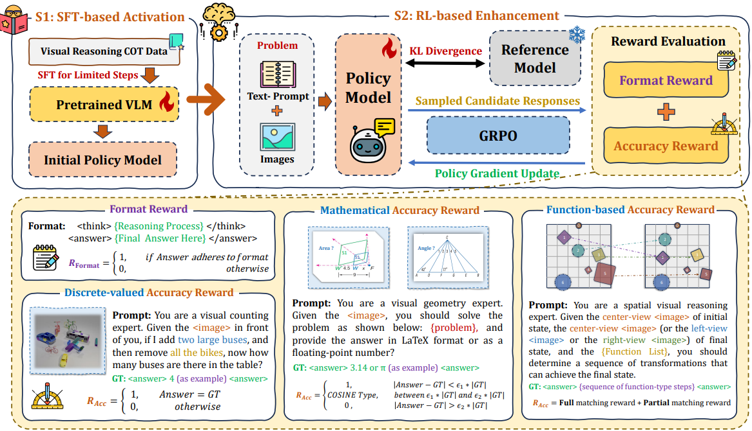
Second Success: Diverse Task——Take Vision as an Example
Reason-RFT
Visual Counting, Structure Perception, Spatial Transformation

Slide 16
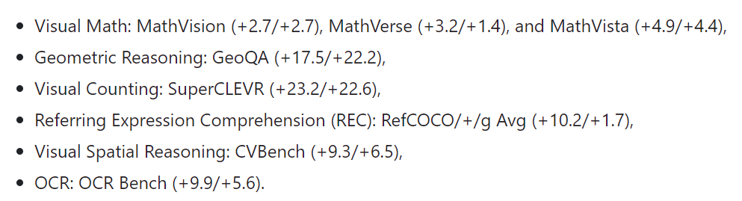
Second Success: Diverse Task——Take Vision as an Example
Ocean-R1

Slide 17
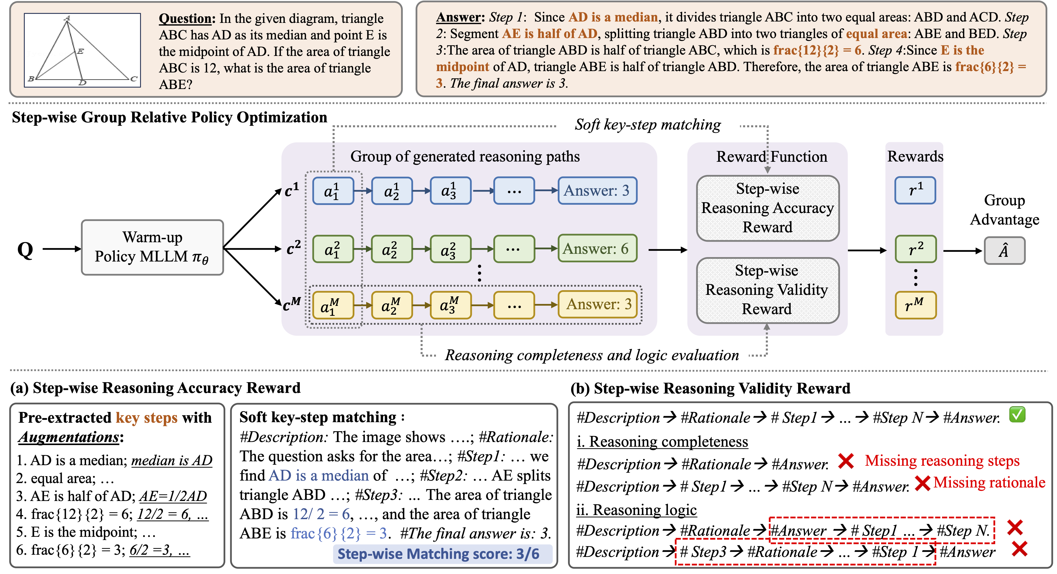
Third Success: Better Algorithms——Take Vision as an Example
R1-VL

Slide 18
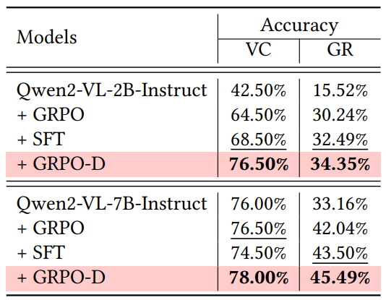
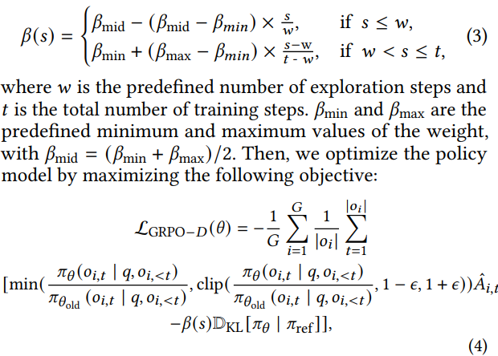
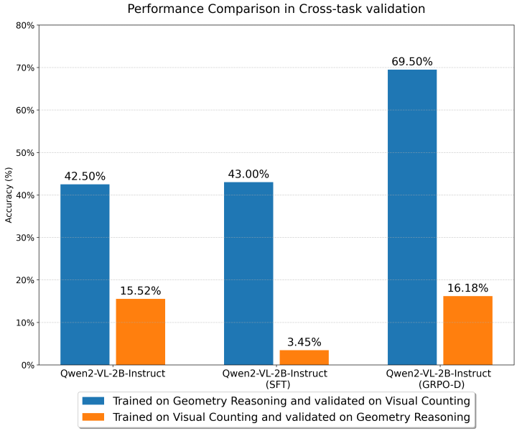
Third Success: Better Algorithms——Take Vision as an Example
OThink-MR1: Dynamic KL

Slide 19
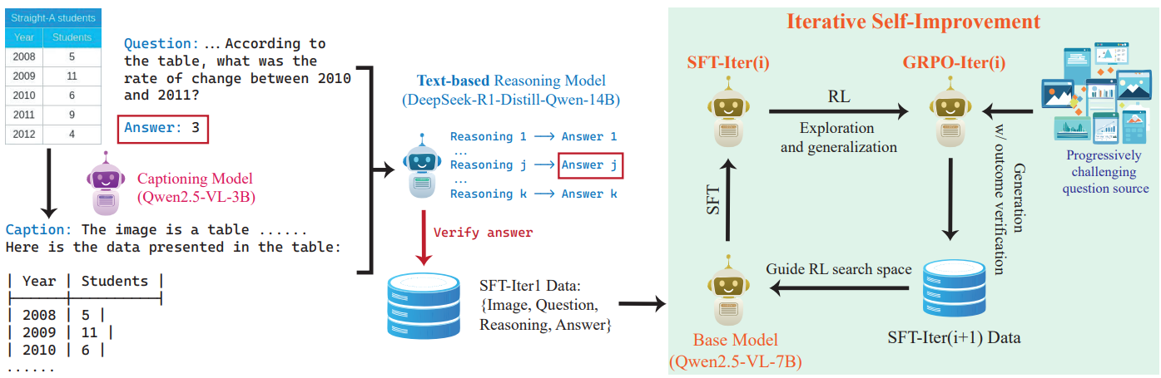
Third Success: Better Algorithms——Take Vision as an Example
OpenVLThinker: Iterative Self-Improvement

Slide 20
What could the community do next?

Slide 21


To Do 1: Focus Further than Textual Modality
Take Vision Images as an Example
Center Crop
Flip
Invert
rotation
Initial
Random Crop
Affine
Diffusion (Add Noise)
Mixed

Slide 22
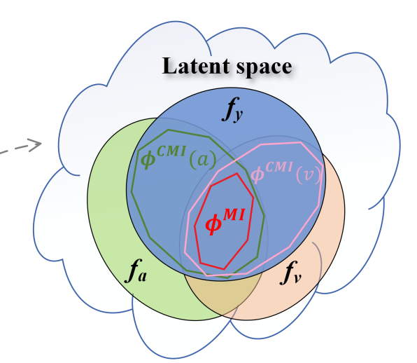
To Do 2: Give Attention to Multi-modal Asymmetric
Reference: Gao X, Cao B, Zhu P, et al. Asymmetric Reinforcing against Multi-modal Representation Bias[J]. arXiv preprint arXiv:2501.01240, 2025.

Slide 23
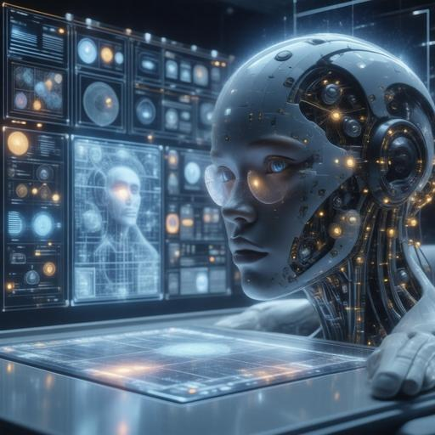
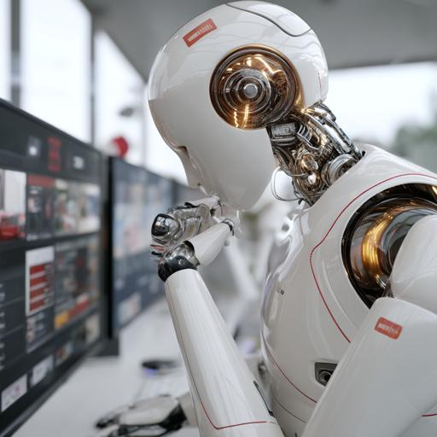
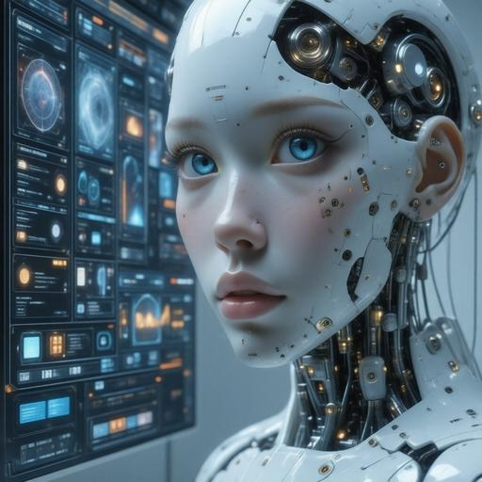
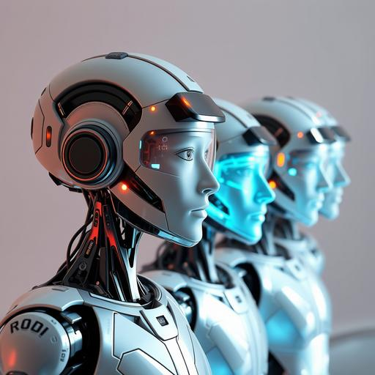
To Do 3: Call for Multimodal Reasoning Agents
Deep Reasoning
Trustworthy Action
Environmental Aware
Multi-Agent System

Slide 24
To Do 4: More Than LLM-Grounded Algorithms
Call for Algorithms Grounded in Multimodal
?
DAPO
ADORA

Slide 25
Thanks
Speaker: Haoyuan Sun

